Slide 1
Basis of Trade (Inter-Industry) Dr. Anwesha Aditya IIT Kharagpur

Slide 2
Inter Vs. Intra Industry Trade
Inter Industry Trade is export and imports of commodities belonging to different industry groups.
For example, India exports rice, fruits and vegetables, textiles, and imports wheat, sugar, scientific instruments.
Intra Industry Trade is export and import of similar, though not necessarily identical, commodities.
For example, software or automobiles of different varieties and models, being exported and imported by India.

Slide 3
Traditional Trade Theory and New Trade Theories
Dissimilarity of countries is the basis of trade in traditional trade theory.
New trade theories explain trade among similar countries due to economies of scale, product differentiation and love-for-variety, strategic motives of firms.

Slide 4
Basis of Inter industry Trade
Arbitrage – buying cheap and selling dear – is the basic force behind trade
Over time
Across space
Trade
Domestic
International

Slide 5
Traditional Trade Theory and New Trade Theories
Dissimilarity of countries is the basis of trade in traditional trade theory.
New trade theories explain trade among similar countries due to economies of scale, product differentiation and love-for-variety, strategic motives of firms.

Slide 6
Why do prices differ?
Relative scarcity or abundance
However, please note that :
Transport cost should not erode cross country relative price difference;
Whether price is lower with respect to potential competitors.
Notes:
‹#›

Slide 7
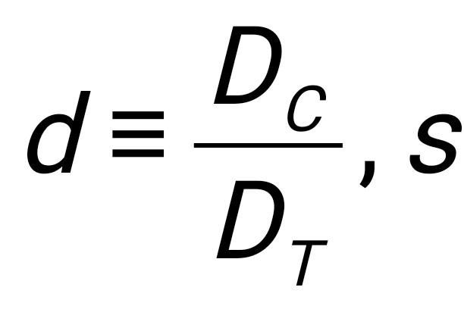
Cross-Country Pre-Trade Relative Price Differential
p
d_{U}
d_{I}
s
s'

Slide 8
Demand and supply biases and pattern of trade
p
s_{U}
s_{U}
s_{I}
s_{I}
p
p_{I}
p_{U}
p_{U}
p_{I}
d_{I}
d_{I}
d_{U}
d_{U}
d, s
d, s
a) A larger supply bias and export of computers
b) A larger demand bias and import of computers

Slide 9
Concepts of Comparative Advantage
Comparative Advantage of a nation in any commodity reflects lower pre-trade relative price of that commodity than elsewhere.
Comparative Cost Advantage reflects a country’s ability to produce a good at a lower cost relative to other goods than its trading partner.
Only under constant costs and perfect competition CCA implies CA (or relative price differences).
In reality price differentials may not always reflect cost differentials, say, when marginal costs are increasing. Thus, a country may have CA in goods in which it has comparative cost disadvantage in the Ricardian sense.
Pattern of trade is dictated by the CA.

Slide 10
Comparative Advantage Vs. Absolute Advantage
Absolute Advantage reflects a country’s ability to produce a good at a lower price (or at a lower cost) than its trading partner- Adam Smith;
No trade between countries one of which is technologically superior than the other.
By CA trade can take place between US and Bangladesh, when US is not equally superior to Bangladesh in all lines of production.
Ricardo’s example of lawyer and secretary.

Slide 11
Sources of Comparative Advantage
Cross-country differences in the fundamentals:
Technology asymmetry of countries: David Ricardo
Factor endowment differences across countries: Heckscher-Ohlin-Samuelson explanation
Demand asymmetry or taste bias of countries.
Do away with the impact of taste/preference by assuming homothetic and identical taste

Slide 12
Virtual Trade: The fourth dimension
Time zone difference allows tasks to be performed 24*7 (Marjit, Mandal, Nakanishi, 2020).
Identical countries can enjoy gains from trade if they are located in non-overlapping time zone. This has been enabled by the revolution in ICT.
Apart from the standard determinants of (inter-industry) trade- technology, endowment and preference - time becomes an important determinant and hence, termed as the fourth dimension.

Slide 13
Public Policy and Induced Comparative Advantage
Public policies generate externalities for private sectors:
public investment in infrastructure creating cost advantage, public investment in education and human capital establish comparative advantage in skill-formation.
For example, poor infrastructure in India and the hardware industry
India’s growing CA in IT, ITeS and software.

Slide 14
Perverse Comparative Advantage
Ecological dumping: Comparative advantage in dirty goods arising due to lax environmental standards or taxes that allow it to be priced below the social marginal cost, and thereby establishes a perverse comparative advantage in that good.
Negative externality
leads to
Perverse, rather than genuine, comparative advantage as it is based on underestimation of (social) cost.
The developing countries are often engaged in unfair trade by keeping their national environmental taxes and standards deliberately low.
conflict between the developed and developing countries

Slide 15
p
s
S: SMC or MC corresponding to clean technology
s′
p_{U}
A*
S’: PMC or MC corresponding to dirty technology
p_{I}
A
d
d, s
Environmental Standards and Comparative Advantage

Slide 16
Selective Factor Disadvantage and Shifting Comparative Advantage
Comparative advantage is evolving.
May be a weakness rather than strength in the long run.
Michael Porter (1990): Selective factor disadvantages may induce innovations to transform the disadvantage into an advantage in the long run and in a dynamic competitive world.
For example, cut flower industry of Netherlands.

Slide 17
Measurement of Comparative Advantage
Revealed Comparative Advantage by Bela Balassa (1989): India’s RCA in commodity-k vis-à-vis other countries in the market in the United States can be calculated as:
Share of India in total import of commodity-k by the United States
RCA^{k} = ---------------------------------------------------------------------------------
Share of India in total import of all commodities by the United States
RCA^{k} >1 means India has a RCA in commodity k

Slide 18
India’s Revealed Comparative Advantage in Merchandise Exports ___________________________________12_________________________________________
 | 1996 | 1998 | 2000 | 2002 | 2004 | 2005
Vegetable Products | 3.39 | 4.31 | 3.31 | 3.06 | 2.67 | 2.33
Mineral Products | 0.75 | 0.46 | 0.63 | 0.89 | 1.33 | 1.23
Chemical and Allied Industries | 1.05 | 1.11 | 1.24 | 1.16 | 1.07 | 1.17
Plastic and Rubber Articles | 0.51 | 0.45 | 0.6 | 0.71 | 0.8 | 0.72
Wood and Articles of Wood | 0.1 | 0.06 | 0.07 | 0.08 | 0.09 | 0.1
Textiles | 4.21 | 4.37 | 4.65 | 3.89 | 3.12 | 3.54
Footwear, Headgear | 1.61 | 1.9 | 1.82 | 1.44 | 1.48 | 1.49
Natural and Cultured Pearls | 7.49 | 9.02 | 8.87 | 8.99 | 9.15 | 7.76
Base Metals | 0.85 | 0.77 | 1.1 | 1.28 | 1.39 | 1.24
Machinery and Mechanical Appliances | 0.2 | 0.18 | 0.2 | 0.21 | 0.22 | 0.24
Vehicles, Aircraft, Transport Equipment | 0.22 | 0.17 | 0.2 | 0.2 | 0.28 | 0.3
Optical, Photographic Precision Equipment | 0.12 | 0.14 | 0.2 | 0.23 | 0.22 | 0.21
____________________________________________________________________________

